Slide 1
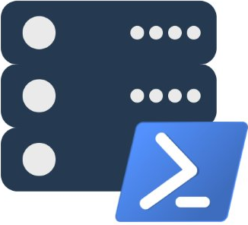
Modern Database Administration with PowerShell and dbatools
Presented by @cl and @ClaudioESSilva
dbatools.io | dbareports.io | sqlps.io | sqlps.io/slack | dbatools.io/youtube

Slide 2
About
Chrissy LeMaire - @cl
PowerShell MVP
Creator of dbatools.io
PASS PowerShell VG, Belgian PowerShell UG
DBA with General Dynamics IT at NATO Spec Ops HQ
Cláudio Silva - @ClaudioESSilva
PowerShell MVP
First Major Contributor to dbatools.io
PASS Portuguese VG Co-lead
DBA and Data Architect at RedGlue
dbatools.io | dbareports.io | sqlps.io | sqlps.io/slack | dbatools.io/youtube

Slide 3

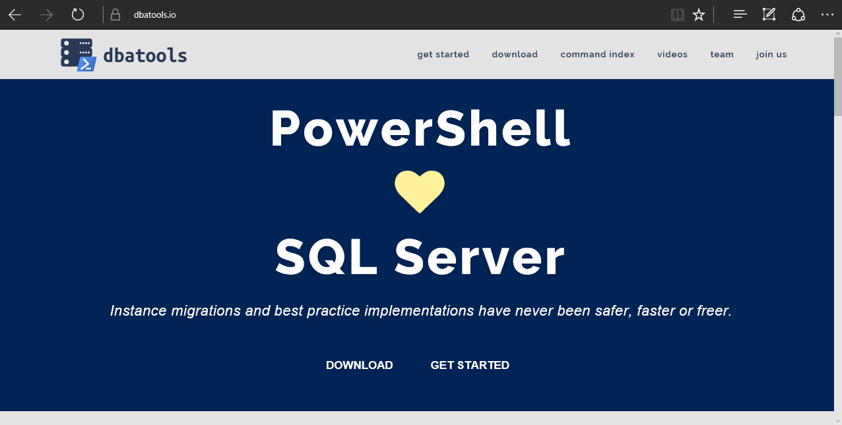
dbatools
dbatools.io | dbareports.io | sqlps.io | sqlps.io/slack | dbatools.io/youtube
Notes:
Community project, initially started out as Start-SqlMigration but has grown into a DBA’s best friend. dbatools currently sports 100 commands.
How many of you have heard of dbatools? How many of you have used it?

Slide 4
System Requirements
Minimum
Client
PowerShell v3
SSMS / SMO 2008 R2
Server
SQL Server 2000
No PowerShell for pure SQL commands
PowerShell v2 for Windows commands
Remote PowerShell enabled for Windows commands
Recommended
Client
PowerShell v5.1
SSMS / SMO 2016
Server
SQL Server 2008R2+
dbatools.io | dbareports.io | sqlps.io | sqlps.io/slack | dbatools.io/youtube
Notes:
Started as a migration tool, so I strived to support older environments
No reliance on SQLPS, because we’ve got a history ;)

Slide 5
Install is easy
PowerShell Gallery
Install-Module dbatools
Install-Module dbatools –Scope CurrentUser
GitHub – dbatools.io/git
Invoke-Expression (Invoke-WebRequest https://dbatools.io/in)
Clone repo found at dbatools.io/git, Import-Module dbatools
dbatools.io | dbareports.io | sqlps.io | sqlps.io/slack | dbatools.io/youtube
Notes:
Gallery requires admin access and is built into PowerShell v5. Other versions also support it with a bit of configuration.
Download
Unzip
Import-Module

Slide 6
Visit the website
dbatools.io | dbareports.io | sqlps.io | sqlps.io/slack | dbatools.io/youtube
Notes:
Community project, initially started out as Start-SqlMigration but has grown into a DBA’s best friend. dbatools currently sports 100 commands.
How many of you have heard of dbatools? How many of you have used it?

Slide 7
demo
dbatools.io | dbareports.io | sqlps.io | sqlps.io/slack | dbatools.io/youtube

Slide 8

Community got us feelin’ like
dbatools.io | dbareports.io | sqlps.io | sqlps.io/slack | dbatools.io/youtube
Notes:
Cut it out.

Slide 9
Review
PowerShell is a DBA’s best friend Migrations Best Practices Reporting
Join us! dbatools.io/slack #dbatools #dbareports
dbatools.io | dbareports.io | sqlps.io | sqlps.io/slack | dbatools.io/youtube

Slide 10
How to Get-Help
Extensive documentation within each command Get-Help Start-DbaMigration –Detailed
Extensive documentation on dbatools.io
dbatools.io/Start-DbaMigration
dbatools.io/Repair-DbaOrphanUser
Some commands have videos
dbatools.io/youtube
dbatools.io | dbareports.io | sqlps.io | sqlps.io/slack | dbatools.io/youtube

